Slide 1
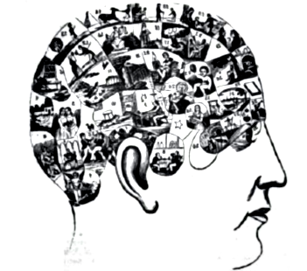

Tutorial
Mental models as probabilistic programs
Do it yourself!
Kevin Smith
Kelsey Allen
August 15, 2018

Slide 2
Thanks to Tobias Gerstenberg for the slides!
He’s building his lab!
http://cicl.stanford.edu/

Slide 3
"Progress in science depends on new techniques, new discoveries and new ideas, probably in that order."
-Sydney Brenner

Slide 4

Tug of War

Slide 5

Tom
Steve

Slide 6
Tom
Steve

Slide 7

Tom
Steve
very weak
very strong

Slide 8

Bill
Mark
Nick
very weak
very strong

Slide 9
Tom
Steve
Bill
Steve
Ryan
Steve
very weak
very strong

Slide 10
Tom
Steve
Bill
Steve
Ryan
Steve
very weak
very strong

Slide 11
Concepts:
teams
person
winner
strength
pulling
effort

Slide 12
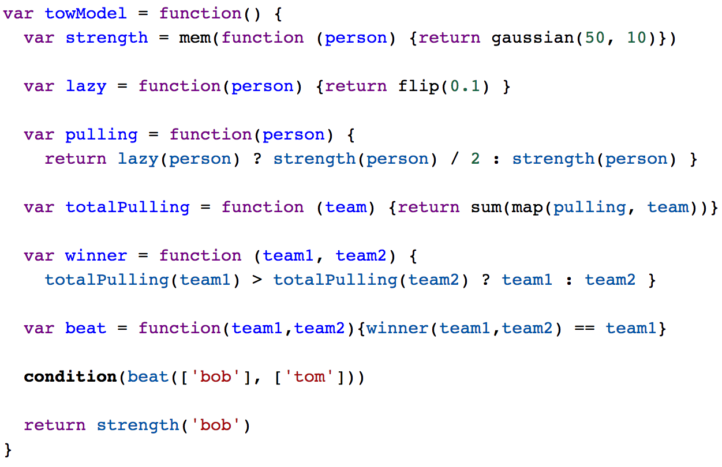
A computational model of tug of war

Slide 13
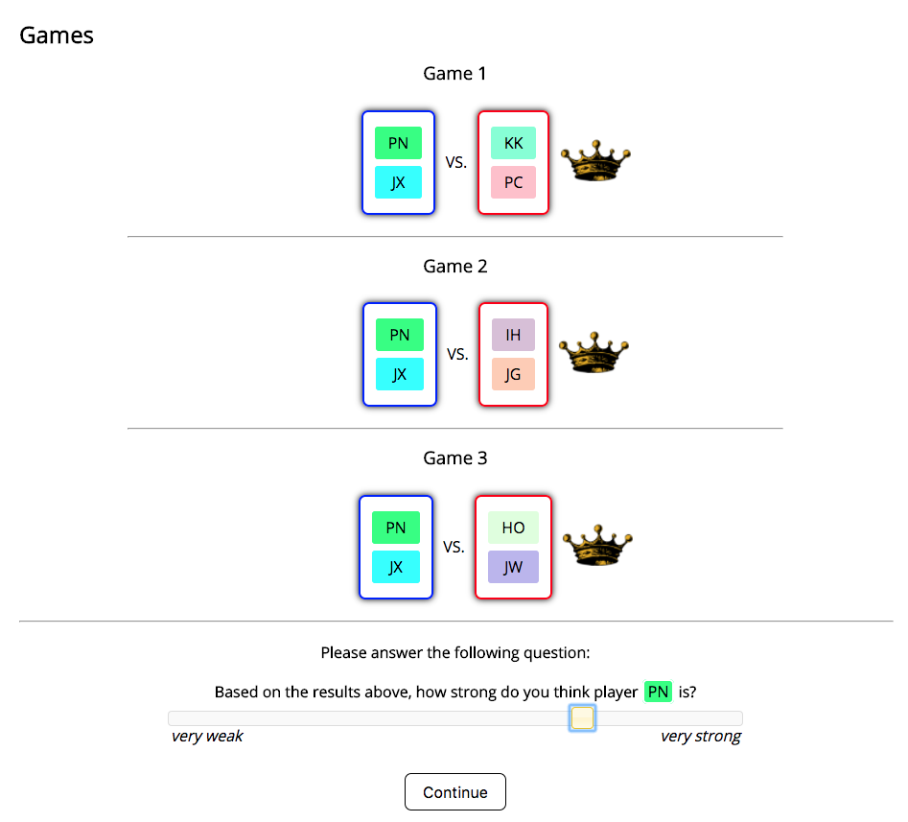
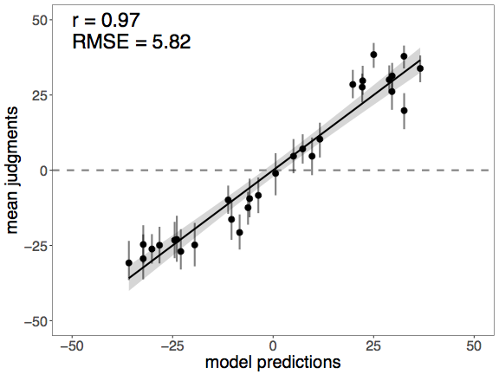
Experiment
How strong is Player X?
Gerstenberg & Goodman (2012) Ping Pong in Church: Productive use of concepts in human probabilistic inference. Cognitive Science Proceedings
Gerstenberg & Tenenbaum (2017) Intuitive Theories. Oxford Handbook of Causal Reasoning
Goodman, Tenenbaum, & Gerstenberg (2015) Concepts in a probabilistic language of thought. The Conceptual Mind: New Directions in the Study of Concepts

Slide 14
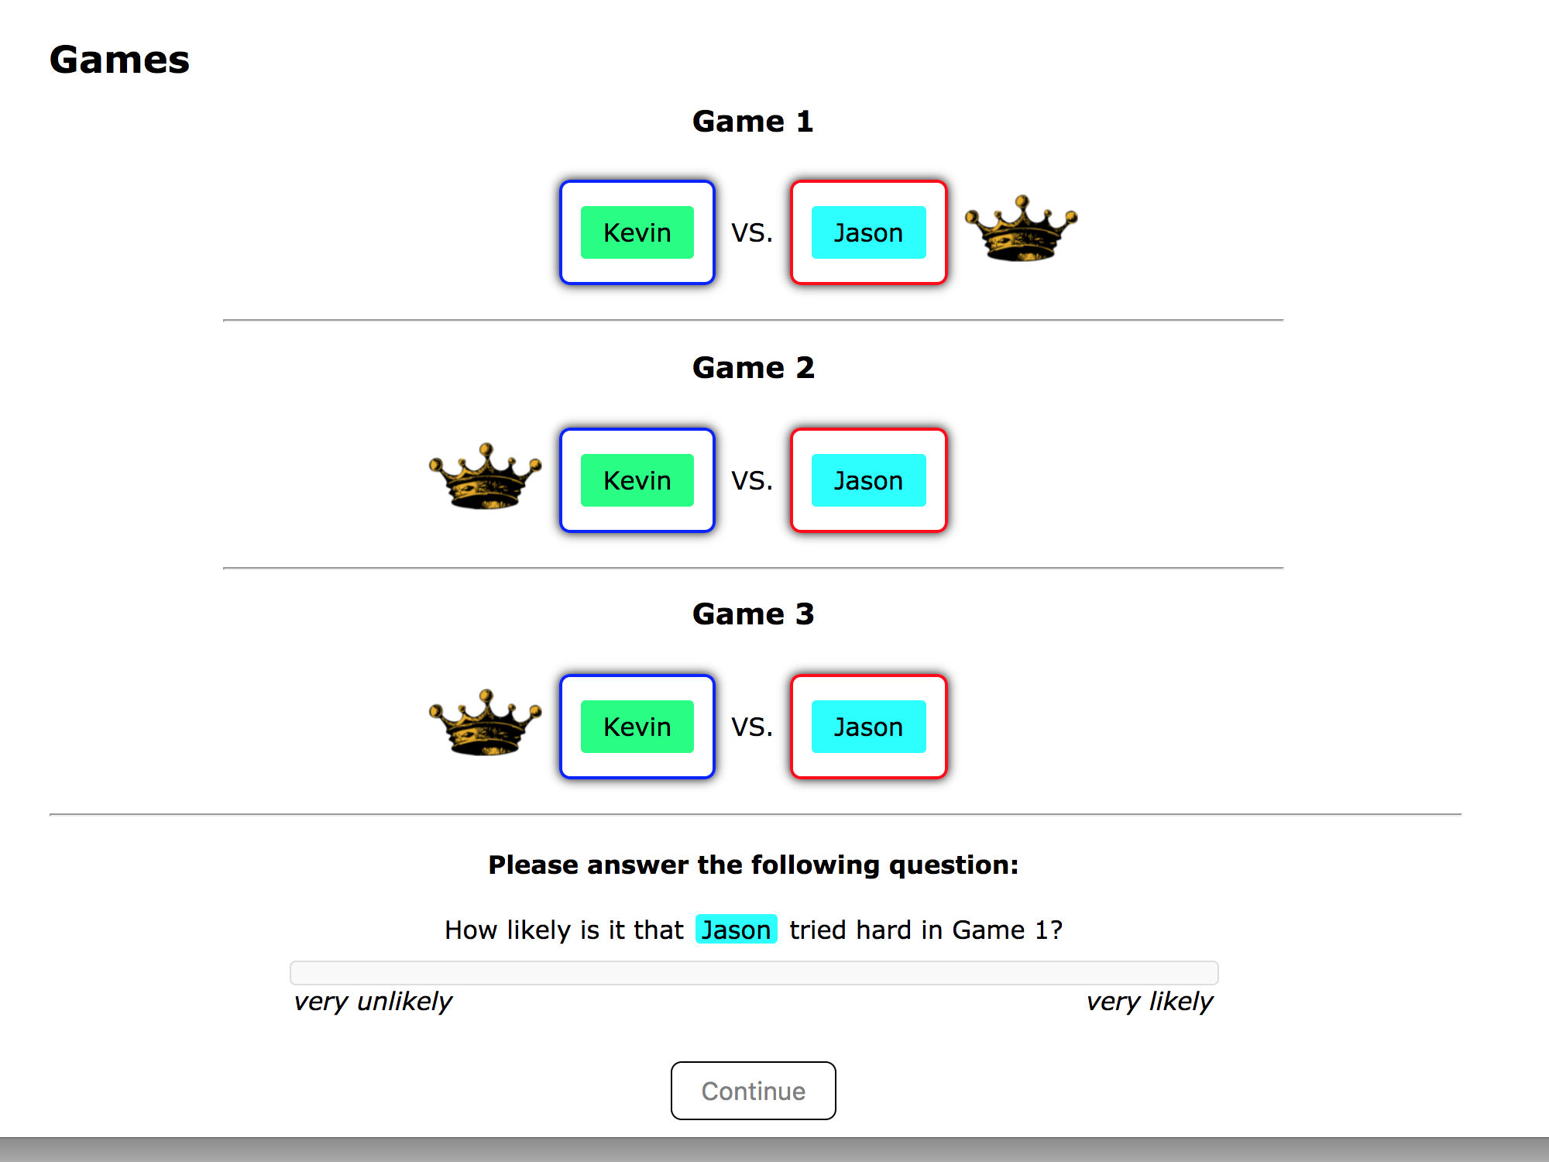
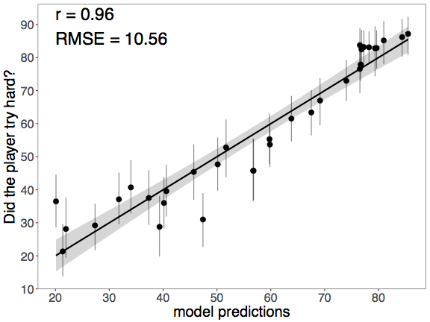
Experiment
Did player X try hard in Game 1?

Slide 15
Outline
What is thinking?
What kind of a program?
Probabilistic language of thought hypothesis
Compositionality
Productivity
Inference
Do it yourself!
WebPPL basics
Building generative models
Doing inference
Questions, Resources, some cool examples

Slide 16
What is thinking?
How can we describe the intelligent inferences made in everyday human reasoning and learning?
How can we engineer intelligent machines?

Slide 17

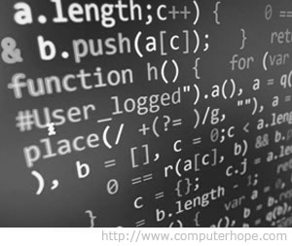
What is thinking?
Computational theory of mind
run(program)
mind = computer
mental representations =
computer programs
thinking =
running a program
What kind of a program?

Slide 18
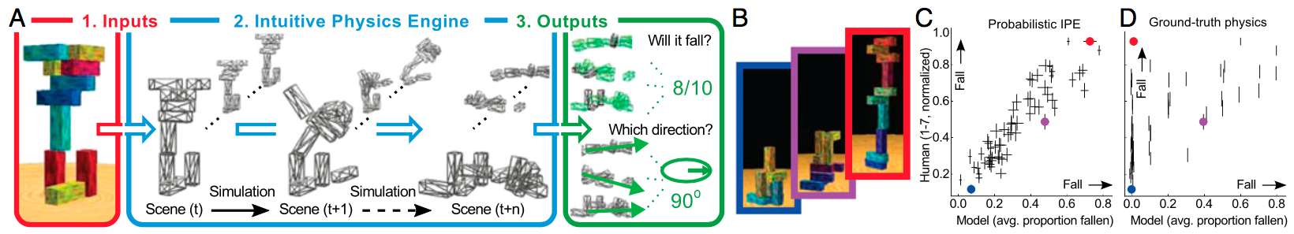
What kind of a program?
Working models of a domain
Battaglia, Hamrick, & Tenenbaum (2013) Simulation as an engine of physical scene understanding. Proceedings of the National Academy of Sciences

Slide 19
What kind of a program?
Structure
Probability
Knowledge
Uncertainty
Tenenbaum, Kemp, Griffiths, & Goodman (2011) How to grow a mind: Statistics, structure, and abstraction. Science

Slide 20
What kind of a program?
Structure
Probability
Logic
Neural networks
Rule-based systems
Knowledge
Uncertainty
Tenenbaum, Kemp, Griffiths, & Goodman (2011) How to grow a mind: Statistics, structure, and abstraction. Science

Slide 21
What kind of a program?
Structure
Probability
Logic
Neural networks
Rule-based systems
Probabilistic programs
Tenenbaum, Kemp, Griffiths, & Goodman (2011) How to grow a mind: Statistics, structure, and abstraction. Science

Slide 22
What kind of a program?
(Causal) Bayesian networks
have “thick arrows”
limited expressiveness
relationships between events / propositions
Probabilistic programs
have rich compositionality
provide a complete specification of the domain (nothing hidden behind arrows)
support productive inferences
support reasoning about events, properties, agents, objects, …

Slide 23
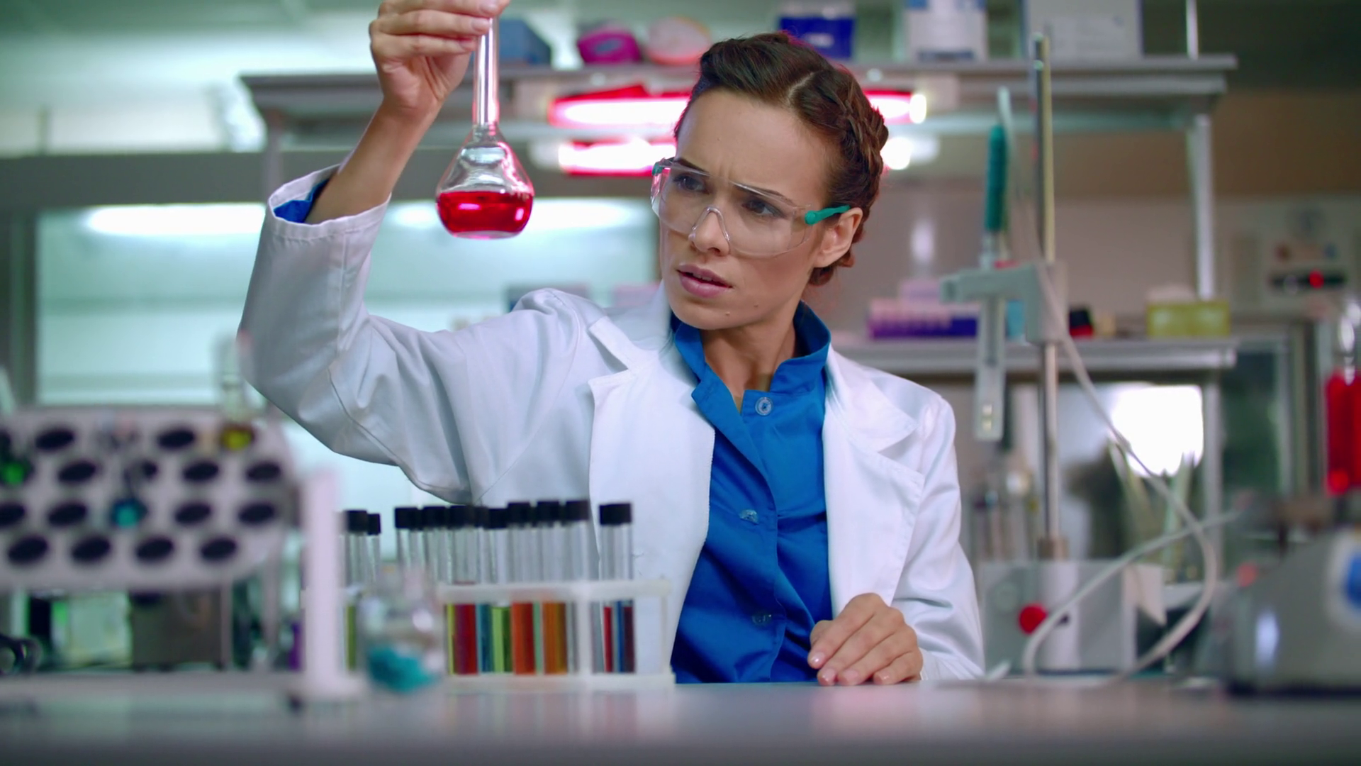
“Where is this in the brain?”
?

Slide 24
Probabilistic language of thought hypothesis
Informal version:
“Concepts have a language-like compositionality and encode probabilistic knowledge. These features allow them to be extended productively to new situations and support flexible reasoning and learning by probabilistic inference.“
Fodor (1975). The language of thought
Goodman, Tenenbaum, & Gerstenberg (2015) Concepts in a probabilistic language of thought. The Conceptual Mind: New Directions in the Study of Concepts

Slide 25
Probabilistic language of thought hypothesis
Informal version:
“Concepts have a language-like compositionality and encode probabilistic knowledge. These features allow them to be extended productively to new situations and support flexible reasoning and learning by probabilistic inference.“
Compositionality
Productivity
"infinite use of finite means”
(Wilhelm von Humboldt)
“A giraffe with a blue ribbon around its neck eats ice cream.”
Language
limited number of letters
fixed set of grammatical rules
can express an infinite number of thoughts
Goodman, Tenenbaum, & Gerstenberg (2015) Concepts in a probabilistic language of thought. The Conceptual Mind: New Directions in the Study of Concepts

Slide 26
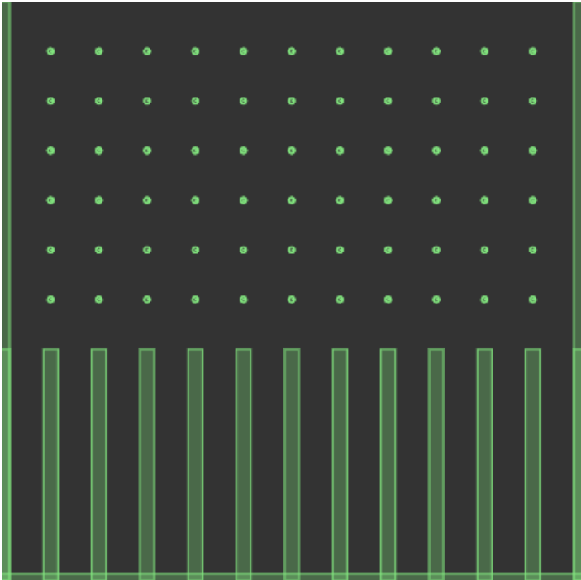
Probabilistic inference
Run forward
Where will the ball land?
Reason backward
Where did the ball come from?

Slide 27
Probabilistic programs

Slide 28
Why WebPPL?
WebPPL
other PPLs
written by cognitive scientists for cognitive scientists
goal: building computational models of cognition
extremely flexible
can be slow
Stan, Anglican, Alchemy, BUGS, Edward, PyMC
goal: building rich models for data analysis
flexible but limited
faster (for the models that can be expressed)

Slide 29
WebPPL basics
Building generative models
Doing inference

Slide 30
http://bit.do/webppl
notes/1_webppl_basics
http://webppl.org

Slide 31
1. WebPPL basics

Slide 32
WebPPL basics
declare variables
data formats: numbers, strings, logicals, objects, arrays
if-then-statements
defining functions
higher order functions
map

Slide 33
WebPPL basics
WebPPL = purely functional programming language
can’t write for loops or while statements
can create higher-order functions and recursive functions
for example: map = apply a function to each element of a list (like a for loop)

Slide 34
2. Building generative models

Slide 35
Building generative models
forward sampling and random primitives
building simple models
sample from probability distributions
memoization: mem
recursive functions

Slide 36
Building generative models
WebPPL is a language to formally describe how the world works
random choices capture our uncertainty or ignorance
the language is universal: it can express any computable process
causal dependence is important: the program describes what influences what
Stuhlmüller, Tenenbaum, & Goodman (2010) Learning Structured Generative Concepts. Cognitive Science Proceedings
Stuhlmüller & Goodman (2014) Reasoning about reasoning by nested conditioning: Modeling theory of mind with probabilistic programs. Cognitive Systems Research

Slide 37
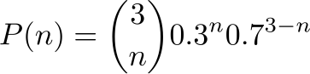
Building generative models
relationship between sampling and probability distributions
Random primitives:
var a = flip(0.3)
var b = flip(0.3)
var c = flip(0.3)
return a + b + c
=> 1
0
0
=> 0
0
0
…
=> 1
0
1
=> 2
0
1
}
}
≅
Sampling
Distributions
any computable distribution can be represented as the distribution induced by sampling from a probabilistic program
Goodman, Mansinghka, Roy, Bonawitz, & Tenenbaum (2008) Church: A language for generative models. Uncertainty in Artificial Intelligence

Slide 38
3. Doing inference

Slide 39
Doing inference
Run forward
Where will the ball land?
Reason backward
Where did the ball come from?

Slide 40

Doing inference
Conditional inference:
Infer(
function(){
var a = flip(0.3)
var b = flip(0.3)
var c = flip(0.3)
return a + b + c})
Posterior distribution
=> 1
0
0
1
=> 0
0
0
0
=> 1
0
1
0
condition(a + b == 1)
=> T
F
F
T
=> 2
0
1
1
“It is an old maxim of mine that when you have excluded the impossible, whatever remains, however improbable, must be the truth.”

Slide 41
Doing inference
conditioning on variables
rejection sampling
WebPPL’s inference procedures
conditioning on arbitrary expressions
other inference procedures
forward, rejection, enumerate, MH, …
you don’t have to worry about inference. very nice!
WebPPL allows us to parsimoniously describe rich generative model structures and explore the inference patterns that emerge from the interaction of model and data

Slide 42

“Concepts have a language-like compositionality and encode probabilistic knowledge. These features allow them to be extended productively to new situations and support flexible reasoning and learning by probabilistic inference.“
compositionality
…
…
productivity

Slide 43
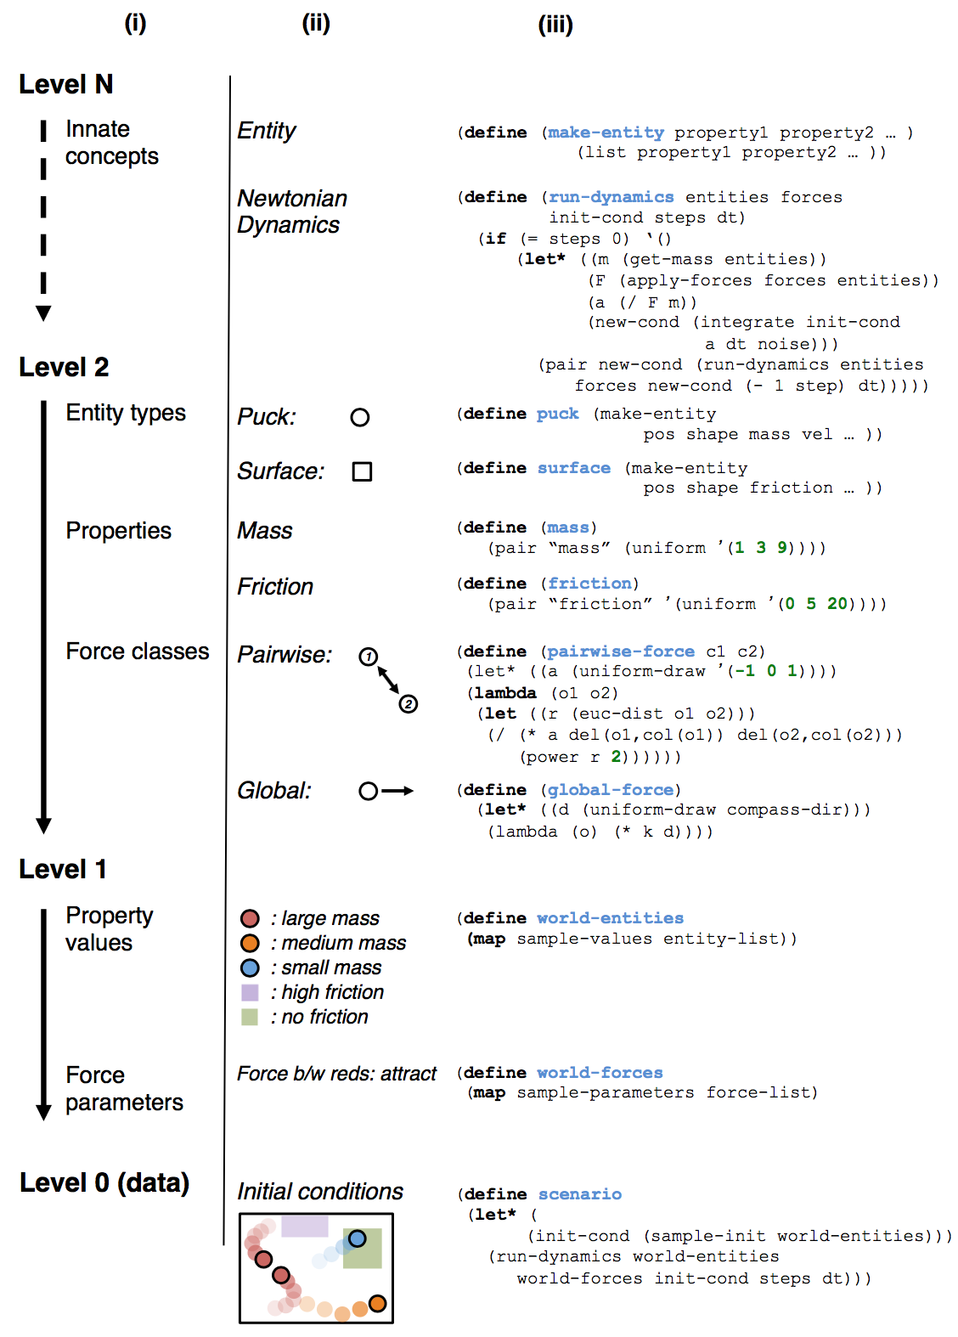
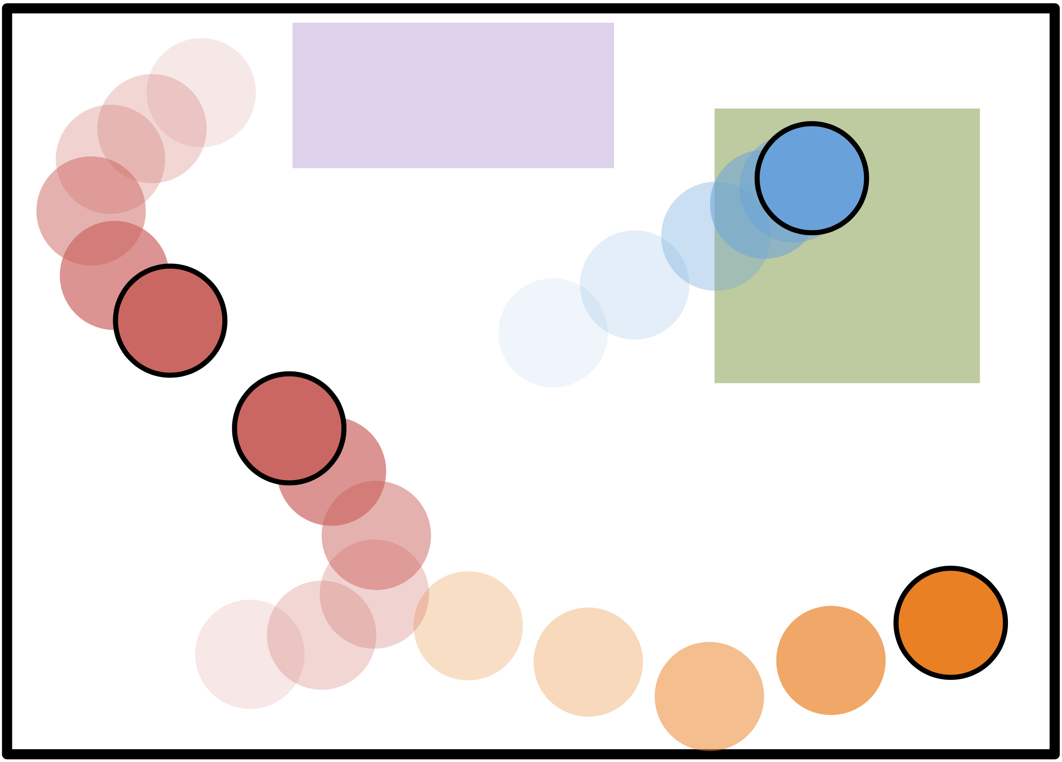
Some more cool examples: Program induction
Learning at theory of physics
Ullman, Stuhlmüller, Goodman, & Tenenbaum (2018) Learning physical parameters from dynamic scenes. Cognitive Psychology

Slide 44
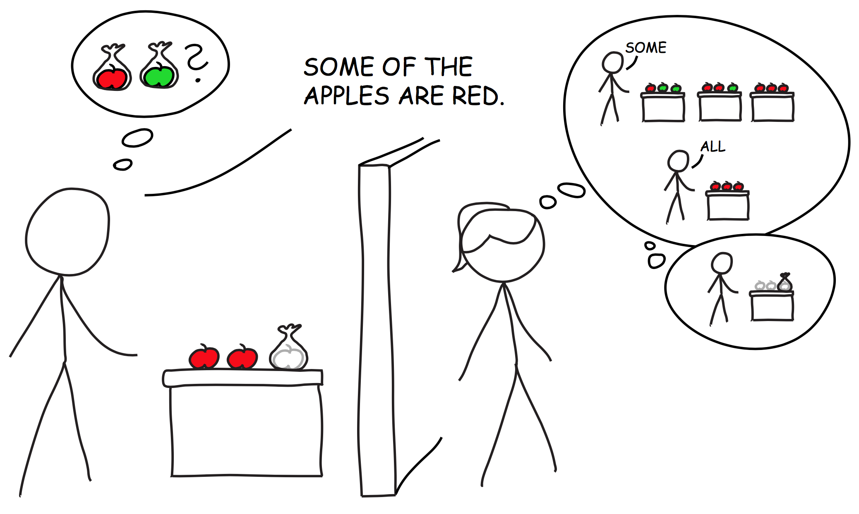
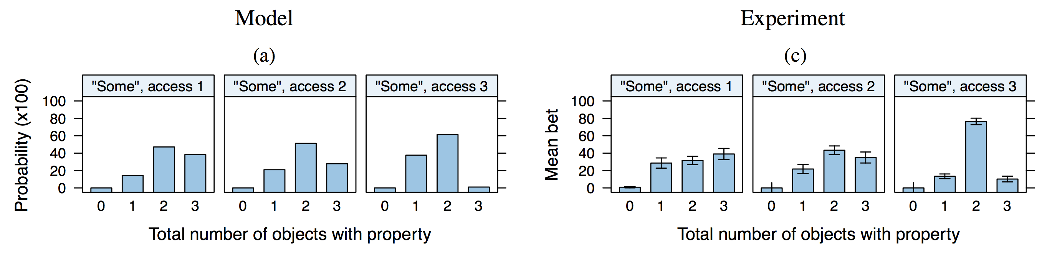
Some more cool examples: Pragmatic inference
Scalar implicature
(“some” but not “all”)
Goodman & Stuhlmüller (2013) Knowledge and implicature: Modeling language understanding as social cognition. Topics in Cognitive Science

Slide 45
Resources: theory
Goodman, Mansinghka, Roy, Bonawitz, & Tenenbaum (2008) Church: A language for generative models. Uncertainty in Artificial Intelligence
https://stanford.edu/~ngoodman/papers/churchUAI08_rev2.pdf
Goodman, Tenenbaum, & Gerstenberg (2015) Concepts in a probabilistic language of thought. The Conceptual Mind: New Directions in the Study of Concepts
web.mit.edu/tger/www/papers/Concepts in a probabilistic language of thought (Goodman, Tenenbaum, Gerstenberg, 2014).pdf
Freer, Roy, & Tenenbaum (2012) Towards common-sense reasoning via conditional simulation: legacies of Turing in Artificial Intelligence. arXiv preprint arXiv:1212.4799
https://arxiv.org/pdf/1212.4799.pdf
Lake, Ullman, Tenenbaum, & Gershman (2016) Building machines that learn and think like people. arXiv preprint arXiv:1604.00289
https://arxiv.org/pdf/1604.00289.pdf
Gerstenberg & Tenenbaum (2017) Intuitive Theories. Oxford Handbook of Causal Reasoning
web.mit.edu/tger/www/papers/Intuitive Theories, Gerstenberg, Tenenbaum, 2017.pdf
Chater & Oaksford (2013) Programs as causal models: Speculations on mental programs and mental representation. Cognitive Science
http://onlinelibrary.wiley.com/doi/10.1111/cogs.12062/abstract
Ghahramani (2015) Probabilistic machine learning and artificial intelligence. Nature
http://www.nature.com/nature/journal/v521/n7553/full/nature14541.html

Slide 46
Resources: practice
https://probmods.org/
many more cool chapters to play around with
http://webppl.org/
Editor to play around with code
http://dippl.org/
Details about WebPPL
https://github.com/probmods/webppl
github repository with latest developments
http://webppl.readthedocs.io/en/master/
function reference for the webppl language
http://agentmodels.org/
Great web book that focuses on how to model agents and inferences about agents
http://probabilistic-programming.org/wiki/Home
homepage comparing different probabilistic programming languages

Slide 47

Thanks!

